Slide 1
Environmental poLlutioN
Created By Albab Hussain

Slide 2
Introduction
Environment pollution become one of the most concerned issue Nowadays. Environment pollution means the introduction of harmful substances into the environment, which can have negative consequences for ecosystems, human societies, and the health of living beings.
There are different types of environment pollution such as soil pollution, Water pollution, Air pollution, Sound pollution etc

Slide 3
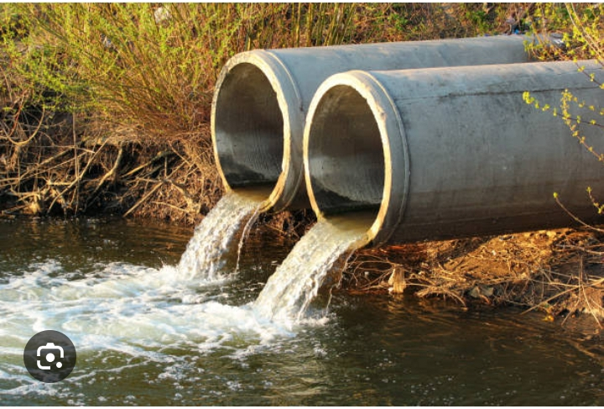
Water pollution
Water pollution is the release of substances into bodies of water that makes water unsafe for human use and disrupts aquatic ecosystems. Water pollution can be caused by a plethora of different contaminants, including toxic waste, petroleum, and disease-causing microorganisms.

Slide 4
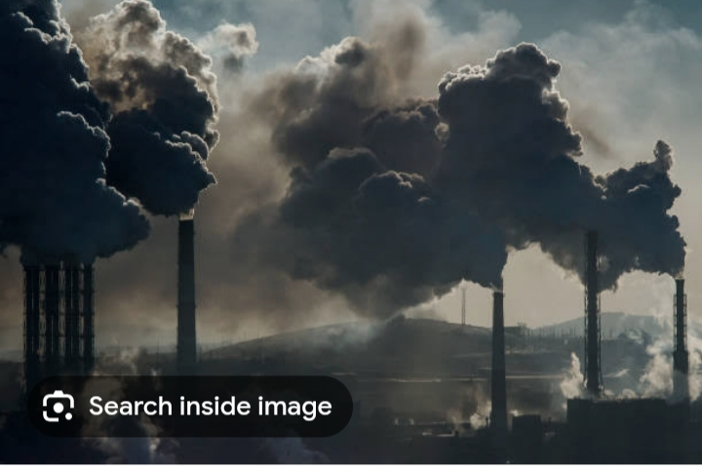
Air pollution
Air pollution is the contamination of air due to the presence of substances called pollutants in the atmosphere that are harmful to the health of humans and other living beings, or cause damage to the climate or to materials.It is also the contamination of the indoor or outdoor environment either by chemical, physical, or biological agent that alters the natural features of the atmosphere.

Slide 5
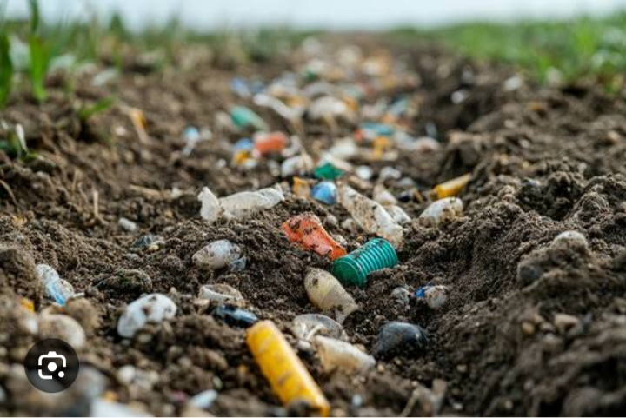
Soil pollution
Soil contamination, soil pollution, or land pollution as a part of land degradation is caused by the presence of xenobiotic (human-made) chemicals or other alteration in the natural soil environment. It is typically caused by industrial activity, agricultural chemicals or improper disposal of waste. The most common chemicals involved are petroleumhydrocarbons,polynuclear aromatic hydrocarbons (such as naphthalene and benzo(a)pyrene), solvents, pesticides, lead, and other heavy metals

Slide 6
Thank you

